Slide 1



Course: Image Processing 31651 Assignment #14 Synthetic Image Creation (Part 4)
Photo of the student | Shorten Name | ID (4 last digits)
 | shienfeld | 1950 | Student #1
 | pony | 2210 | Student #2
 | akimov | 7939 | Student #3
Photo of the student | Shorten Name | ID (4 last digits)
 | shienfeld | 1950 | Student #1
 | pony | 2210 | Student #2
 | akimov | 7939 | Student #3

Slide 2
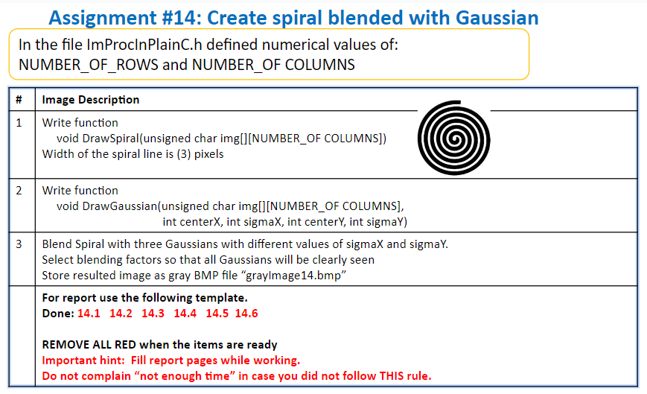

Slide 3
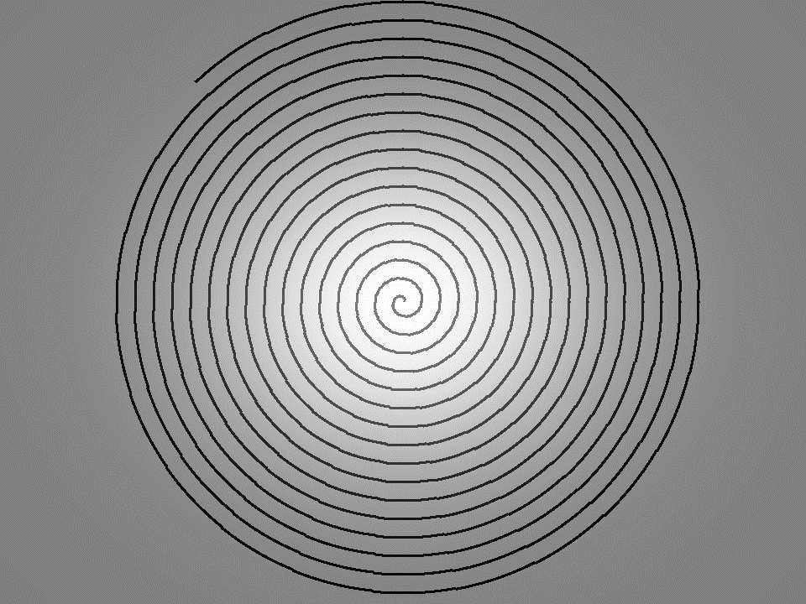
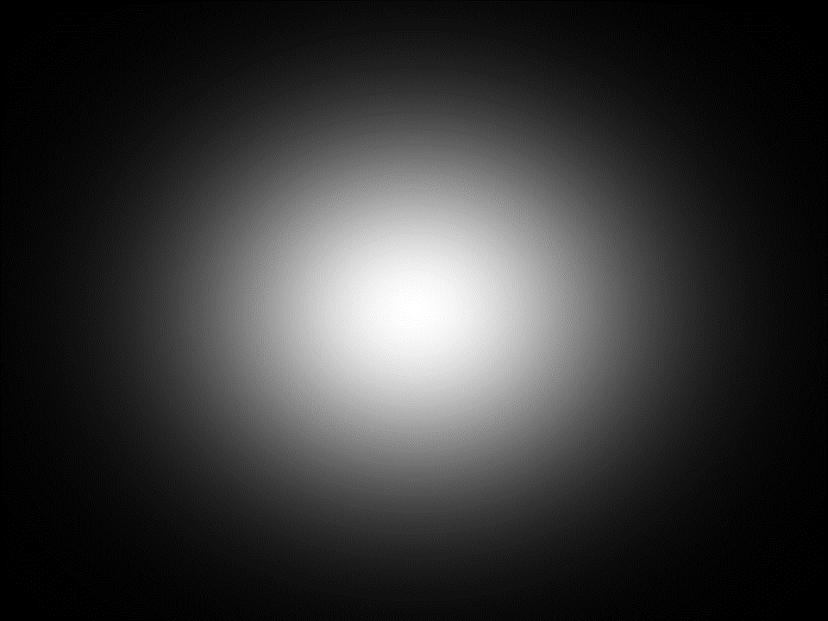
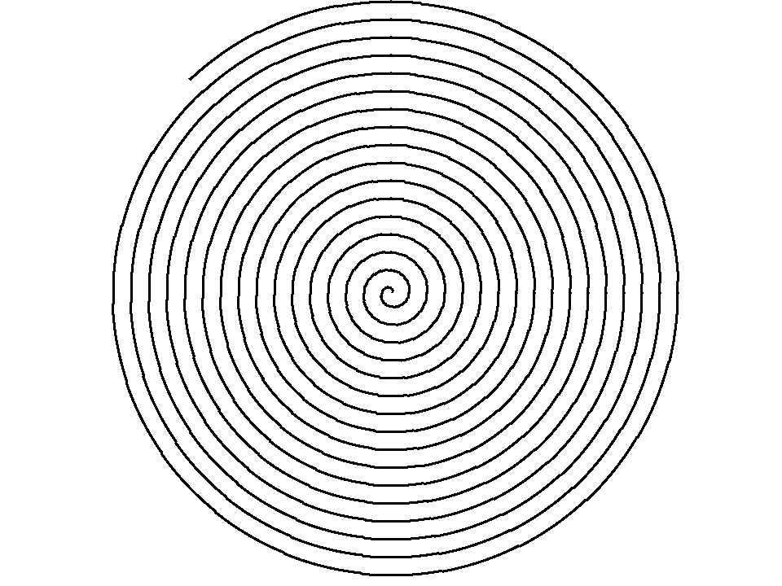
14.1 - our “image of spiral”, “images of Gaussian” and resulted blended image “grayImage14.bmp”
This image also contains a spiral pattern. However, the background is uniformly white, making the black spiral lines more distinct and clearer.
This image features a spiral pattern with gradually increasing radius, starting from the center and moving outward. The background is a gradient from black on the edges to white at the center, creating a sense of depth and a visual effect that makes the spiral stand out prominently.
This image depicts a Gaussian pattern. The intensity of the pixels decreases smoothly from the center towards the edges, forming a bright spot in the middle that gradually fades to black.

Slide 4
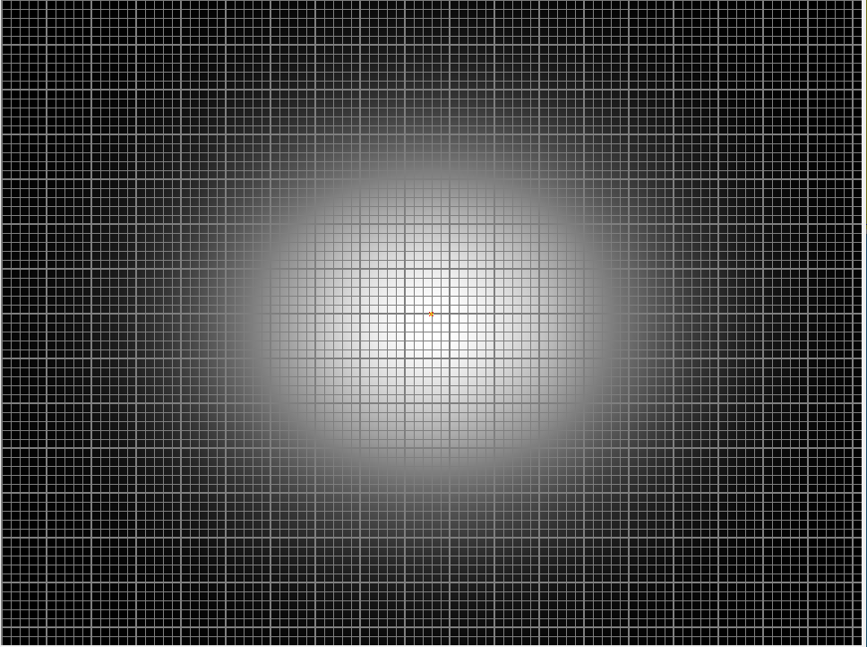
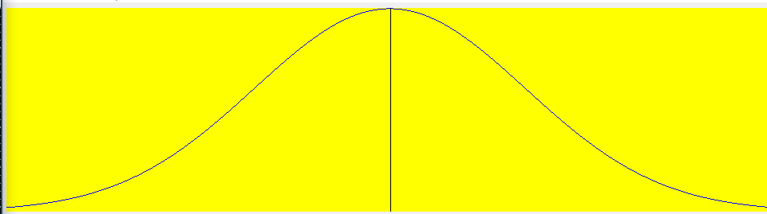
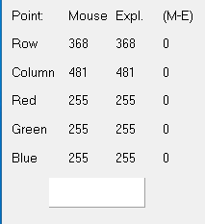
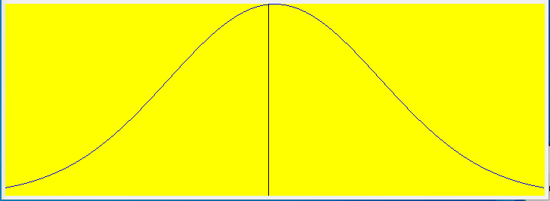
14.2 - The Relevant Profiles (of all relevant images) (to prove that image “grayImage14.bmp” was created as required) - part 1/3
Row view
Gaussian distribution along a single row (row view) of the image.
This bell-shaped curve is typical of the Gaussian distribution, indicating that the brightest point is in the middle and the intensity decreases symmetrically towards the edges.
Gaussian distribution along a single column (column view) of the image. The curve starts with low intensity, peaks at the center, and then decreases symmetrically towards the edges.
location
Column view
RGB values

Slide 5
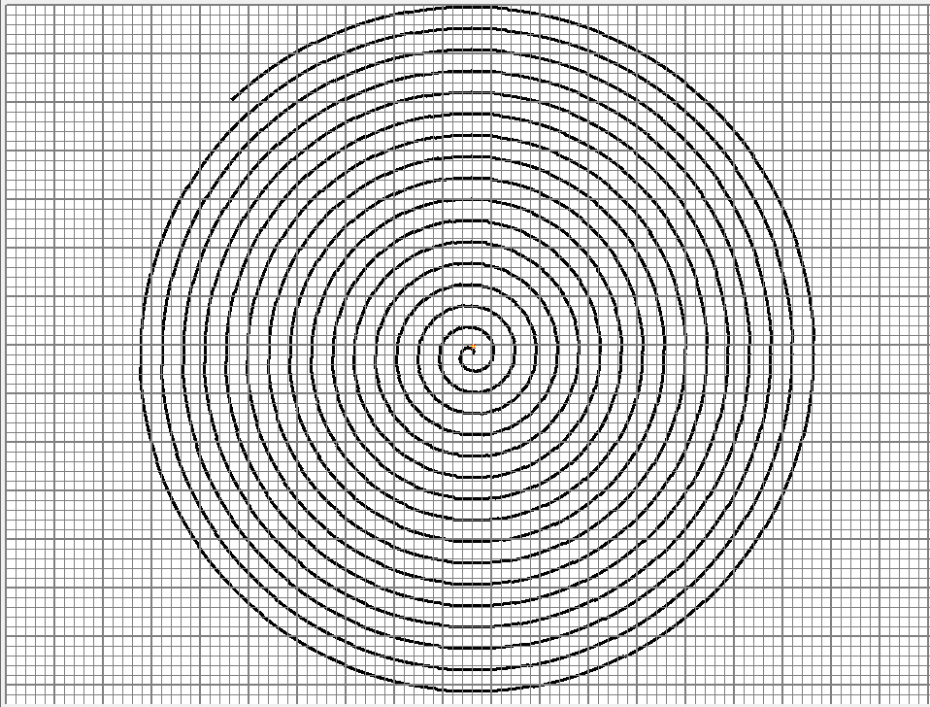
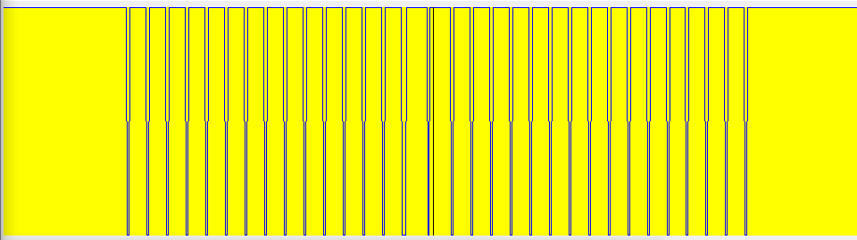
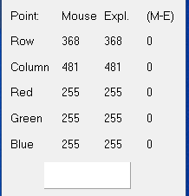
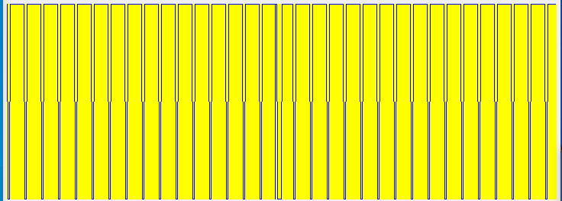
14.2 - The Relevant Profiles (of all relevant images) (to prove that image “grayImage14.bmp” was created as required) - part 2/3
Row view
The intensity profile along a single row (row view) of the spiral image.
The profile displays periodic peaks corresponding to the intersections of the spiral lines with the row. Each peak represents a darker pixel where the spiral line crosses, while the valleys represent the background.
Column view
location
The intensity profile along a single column (column view) of the spiral image. Similar to the row view.
RGB
values

Slide 6
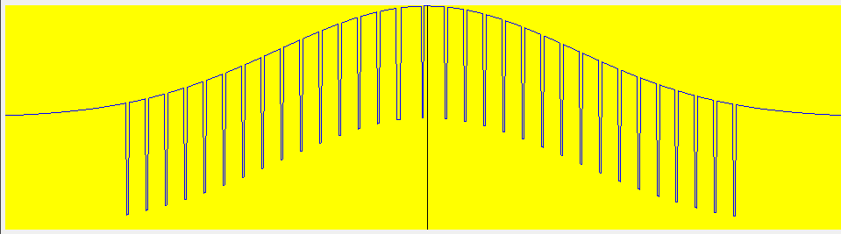
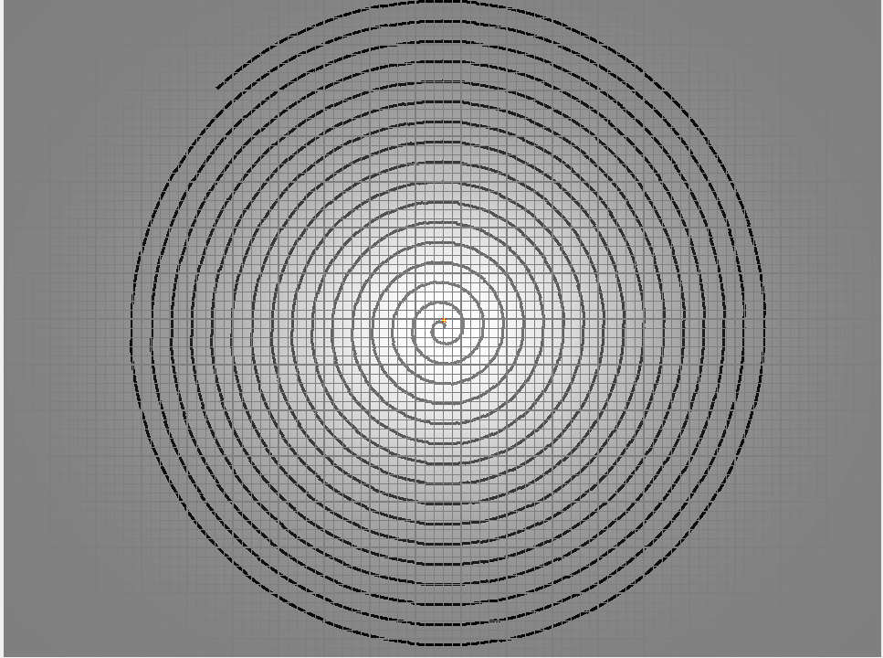
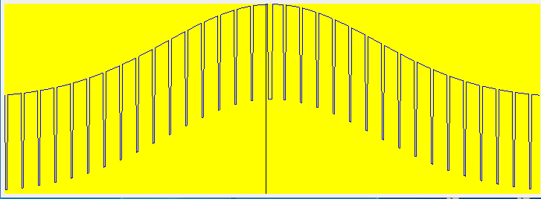
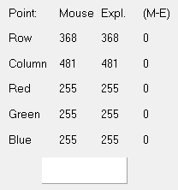
14.2 - The Relevant Profiles (of all relevant images) (to prove that image “grayImage14.bmp” was created as required) - part 3/3
row
column
location
RGB values

Slide 7
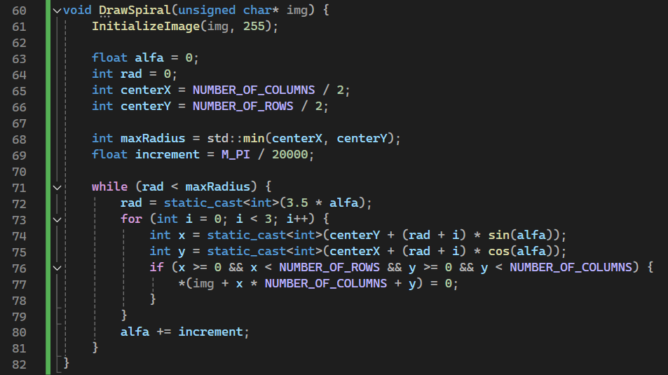
14.3 - Code of the function “DrawSpiral”-part 1/2
calls the InitializeImage function to fill the entire image array with a white background (gray level 255).
alfa: The angle in radians, initialized to 0.
rad: The current radius of the spiral, initialized to 0.
centerX and centerY : The coordinates of the center of the image.
calculates the maximum radius the spiral can reach without going out of bounds of the image. It takes the minimum of centerX and centerY to ensure the spiral fits within the image dimensions.
The DrawSpiral function initializes the image, then uses a loop to draw a spiral pattern by converting polar coordinates (radius and angle) to Cartesian coordinates (x and y) and setting the corresponding pixel values. The spiral grows outward from the center, with the angle and radius increasing incrementally to create the spiral effect.
Continue of the function’s explanation in the next slide

Slide 8
14.3 - Code of the function “DrawSpiral”-part 2/2
rad is updated based on the current alfa value, scaled by a factor of 3.5 to control the spiral's growth rate.
set the increment for alfa, controlling the density and length of the spiral. Smaller values create a tighter spiral.
Calculate Coordinates:
The x and y coordinates of the current point are calculated using polar to Cartesian conversion. The sin and cos functions are used with the current alfa value to determine the coordinates.
Check Bounds and Draw:
If the calculated coordinates are within the image bounds, the pixel value at that location is set to 0 (black), drawing part of the spiral.
alfa is incremented by increment to proceed to the next angle for drawing the next segment of the spiral.

Slide 9
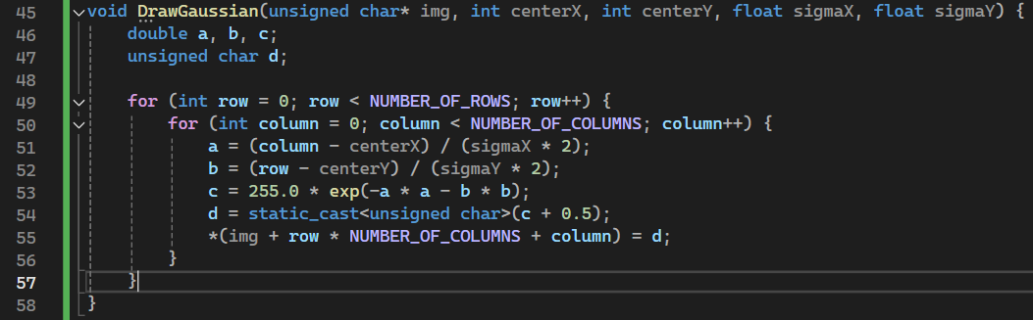
14.4 - Code of the function “DrawGaussian”
The DrawGaussian function fills the image with values according to a 2D Gaussian distribution centered at (centerX, centerY) with standard deviations sigmaX and sigmaY.
Each pixel's intensity is computed based on its distance from the center and scaled to fit within the 0-255 range.
These loops iterate over each pixel in the 2D image array.
a is the normalized horizontal distance from the center of the Gaussian distribution.
b is the normalized vertical distance from the center.
The distances are divided by twice the standard deviation (sigmaX * 2 and sigmaY * 2) to scale the Gaussian function appropriately.
This line computes the Gaussian value using the formula for a 2D Gaussian function. The value is scaled by 255.0 to map it to the 0-255 range
The computed Gaussian value c is rounded to the nearest integer and converted to an unsigned char. The + 0.5 ensures proper rounding.
The final pixel value d is assigned to the appropriate position in the image array. The use of pointers ensures that the correct memory location is accessed and modified.

Slide 10
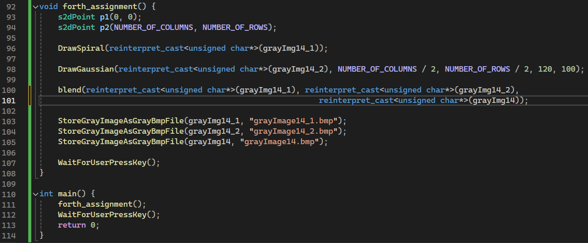
14.5 - Code of the “main” function
p1 is initialized to the top-left corner, and p2 to the bottom-right corner of the image.
The blend function is called to blend grayImg14_1 and grayImg14_2 into grayImg14. The reinterpret_cast converts all three 2D arrays to 1D pointers so that the blending operation can be performed using pointer arithmetic.
The DrawSpiral function is called to draw a spiral pattern on the grayImg14_1 array. The reinterpret_cast converts the 2D array grayImg14_1 to a pointer of type unsigned char*. This allows the function to treat the 2D array as a 1D array for pointer arithmetic.
The DrawGaussian function is called to draw a Gaussian distribution on the grayImg14_2 array, centered at the middle of the image with standard deviations 120 and 100 for the x and y directions, respectively. Again, reinterpret_cast is used to convert the 2D array to a 1D pointer.

Slide 11
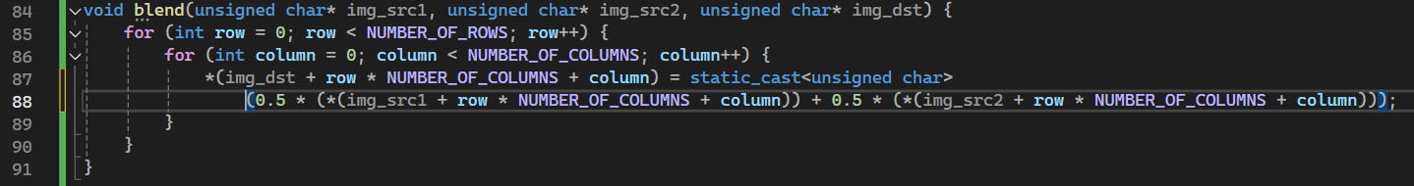
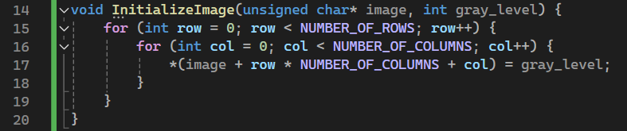
(+) – some additional functions we need to use-part 1

Slide 12
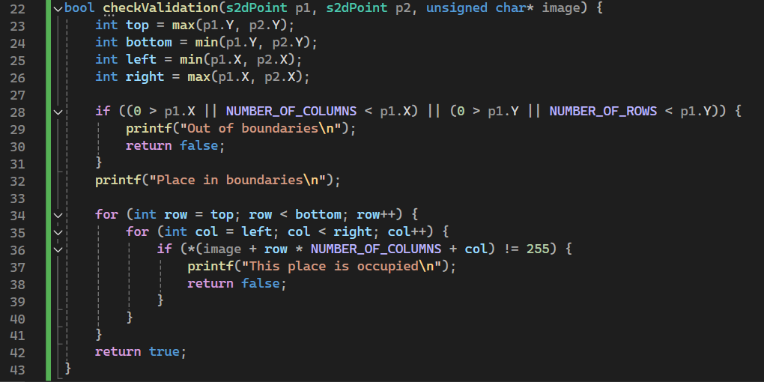
(+) – some additional functions we need to use-part 2

Slide 13
14.6 - What did we learned

